Slide 1
Botnet Detection by Integrating multiple Machine Learning Models
Research progress Report
Thanawat Tejapijaya
31/7/2023

Slide 2
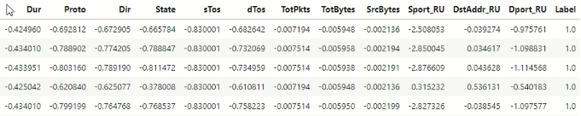
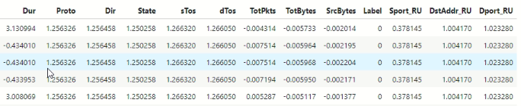
Output data from feature extraction

Slide 3
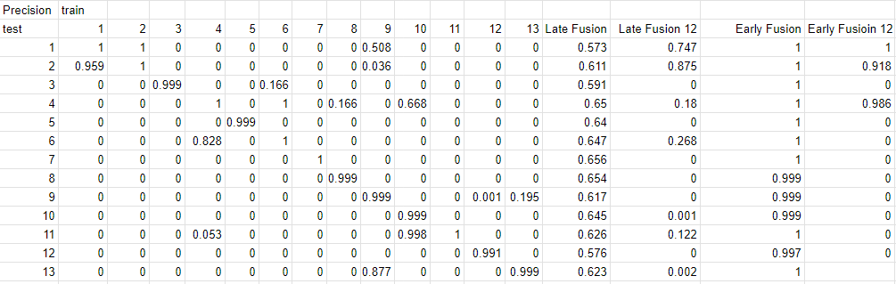
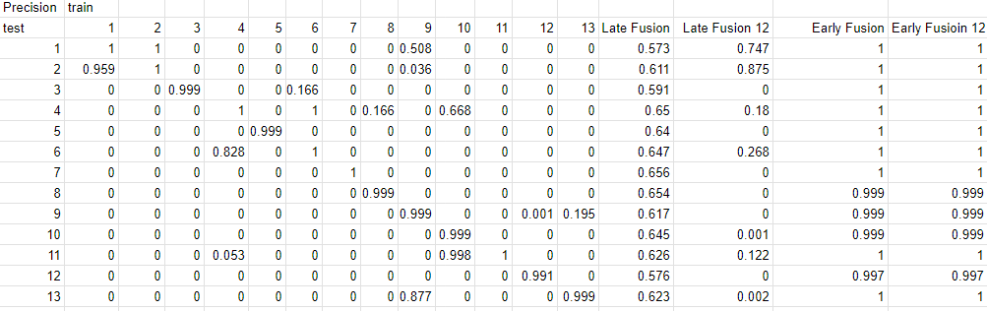
Result(Precision)
Table: Precision score of each model compare with Fusion all model and fusion 12 models

Slide 4
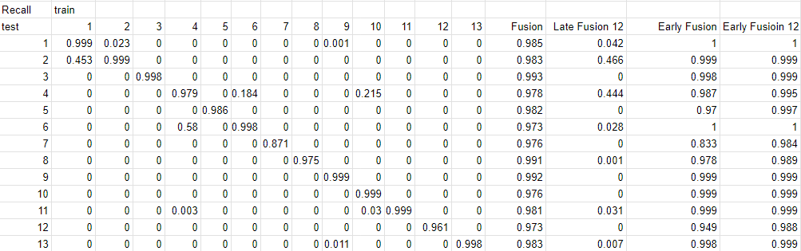
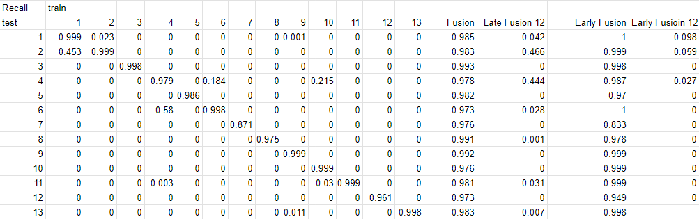
Result(Recall)
Table: Recall score of each model compare with Fusion all model and fusion 12 models

Slide 5
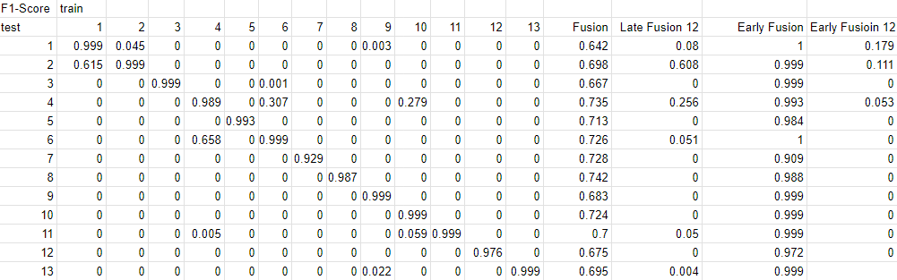
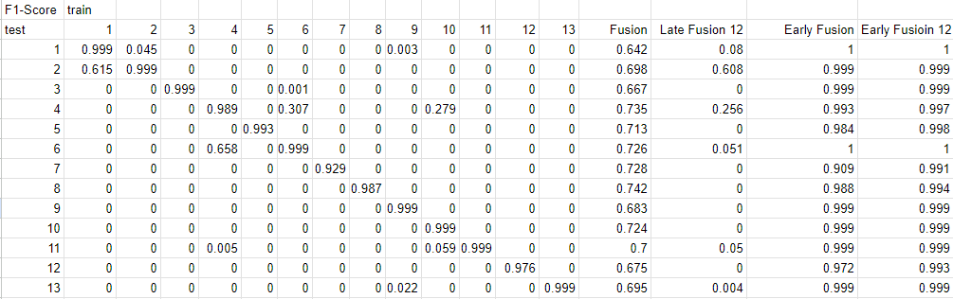
Result(F1-Score)
Table: F1 - score of each model compare with Fusion all model and fusion 12 models

